Slide 1
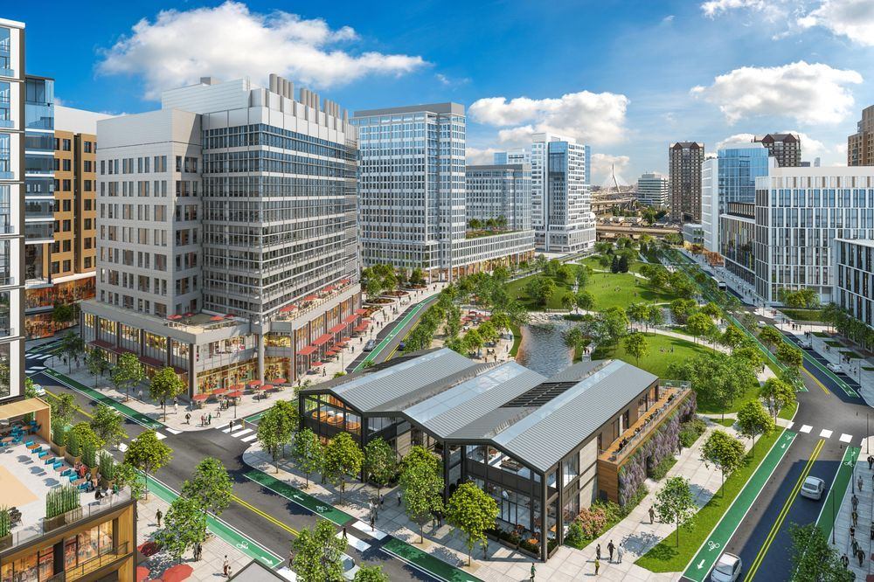
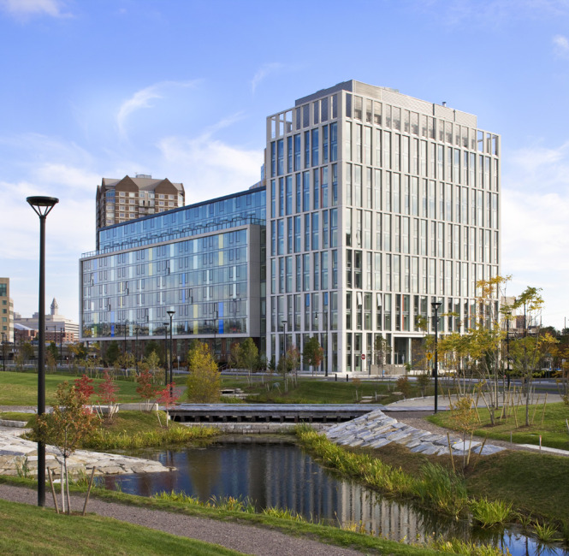
Contact Information
Bill O’Brien
wobrien94@gmail.com
857-270-1764

Slide 2
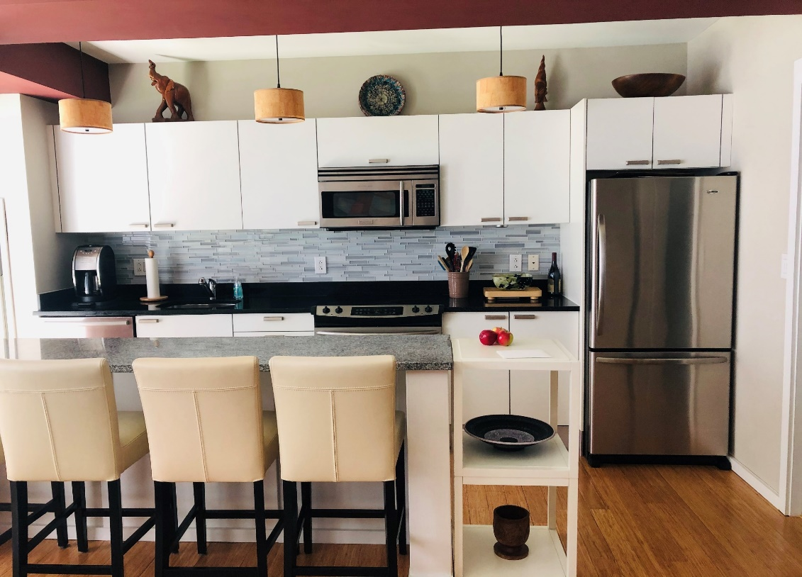
2 Earhart Street unit 312
Great one bedroom living with separate sleeping
area in the heart of the Cambridge Crossing.
Southern exposure, premium appliances with quartz stone countertops,
bamboo floors, great closet space, floor to ceiling windows!
Condo completely furnished except art work does not include kitchen supplies.
Inside Parking #74
$659,900.00

Slide 3
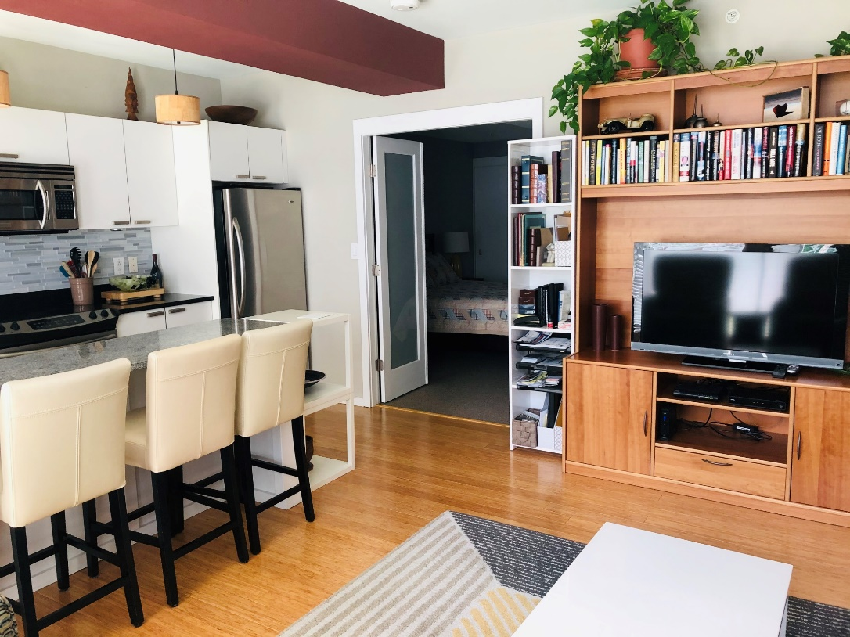
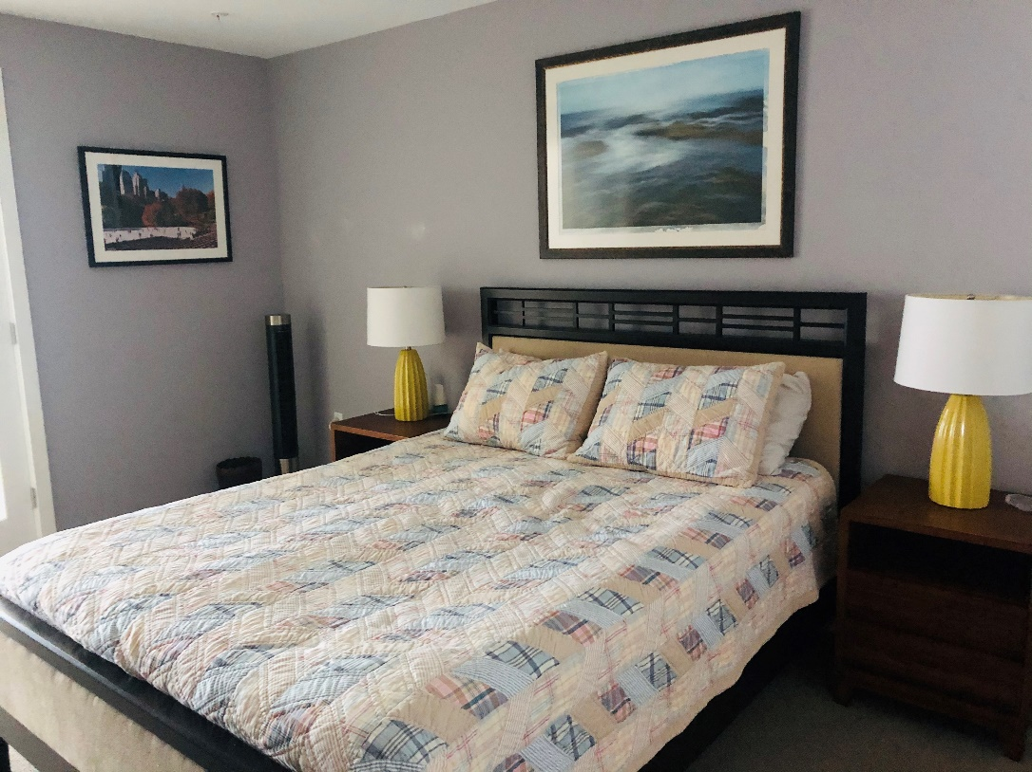
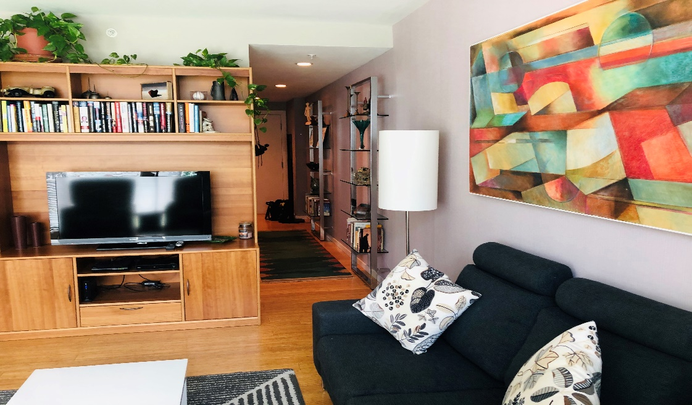
Central Air Condition
In unit washer and dryer
Indoor Bike Rakes
Full time Concierges
Close to the North End- Back Bay
Harvard and MIT

Slide 4
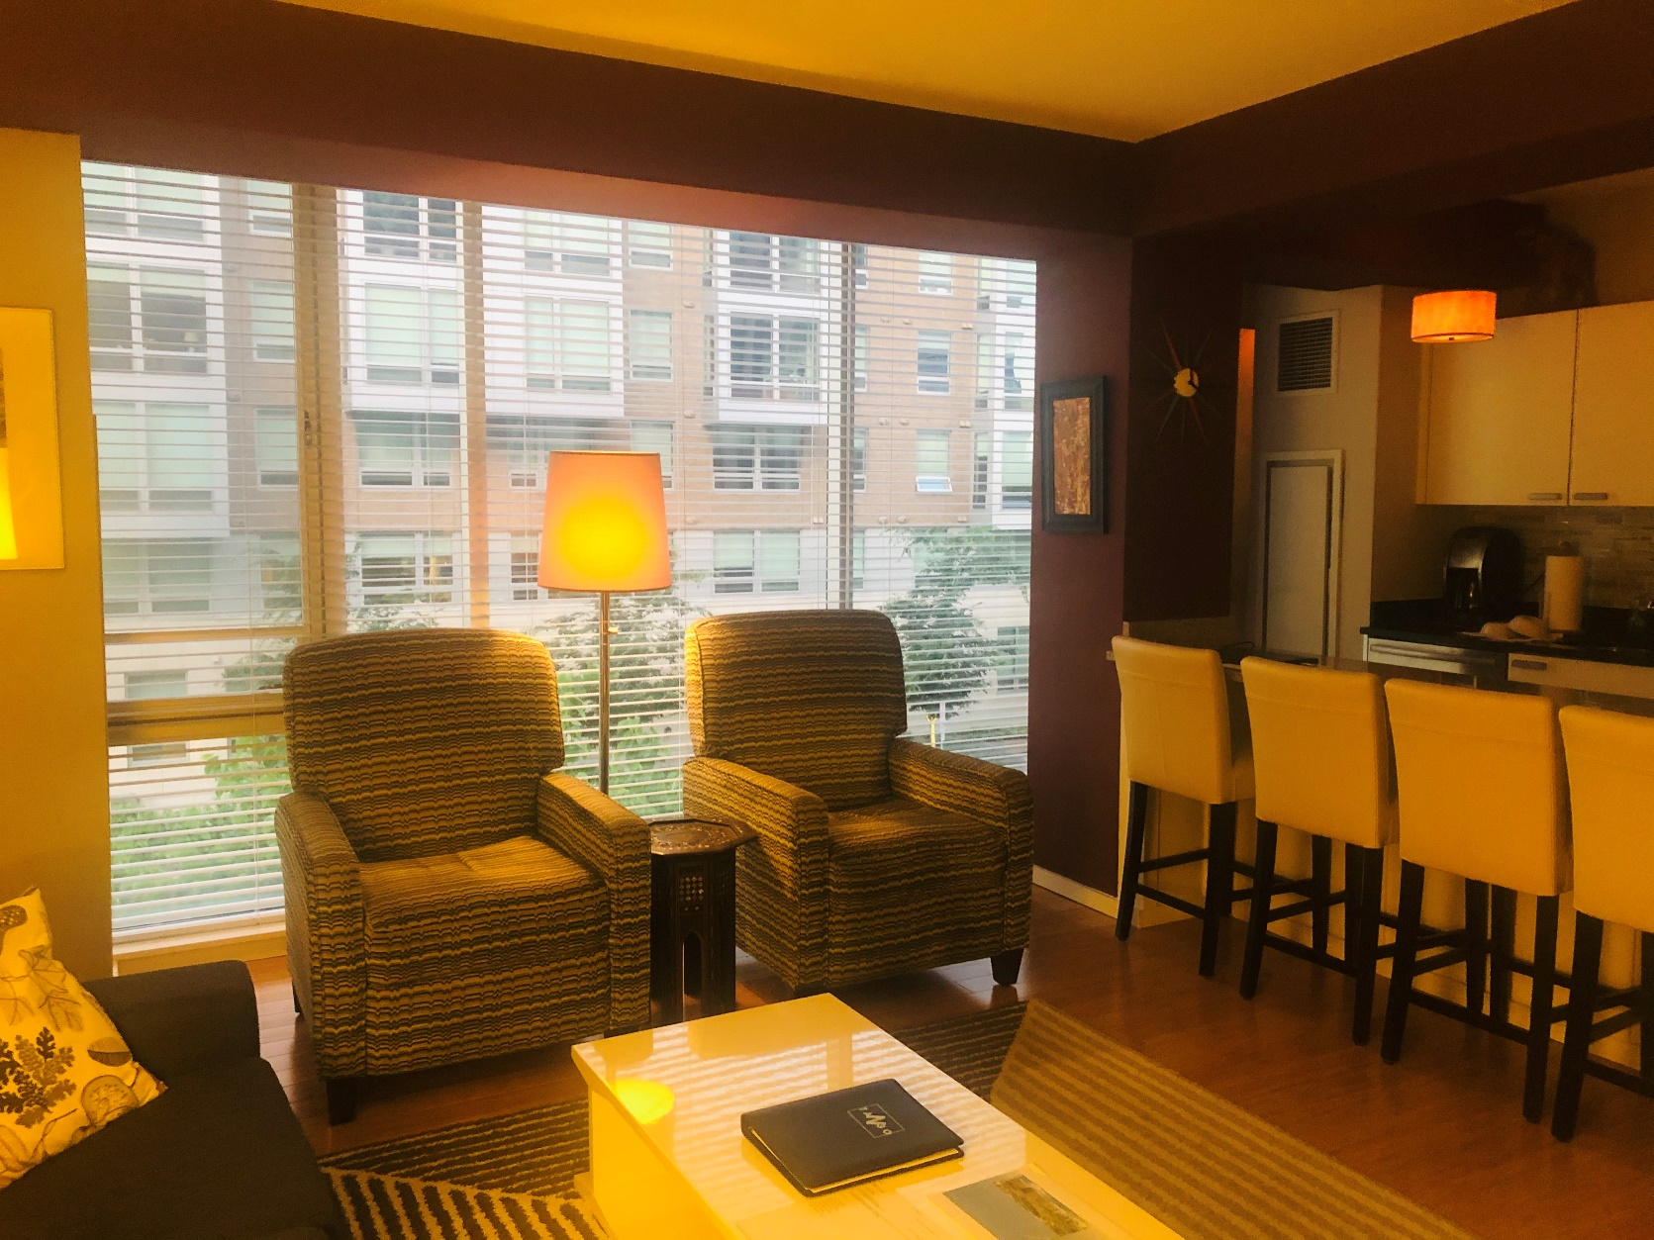

Slide 5
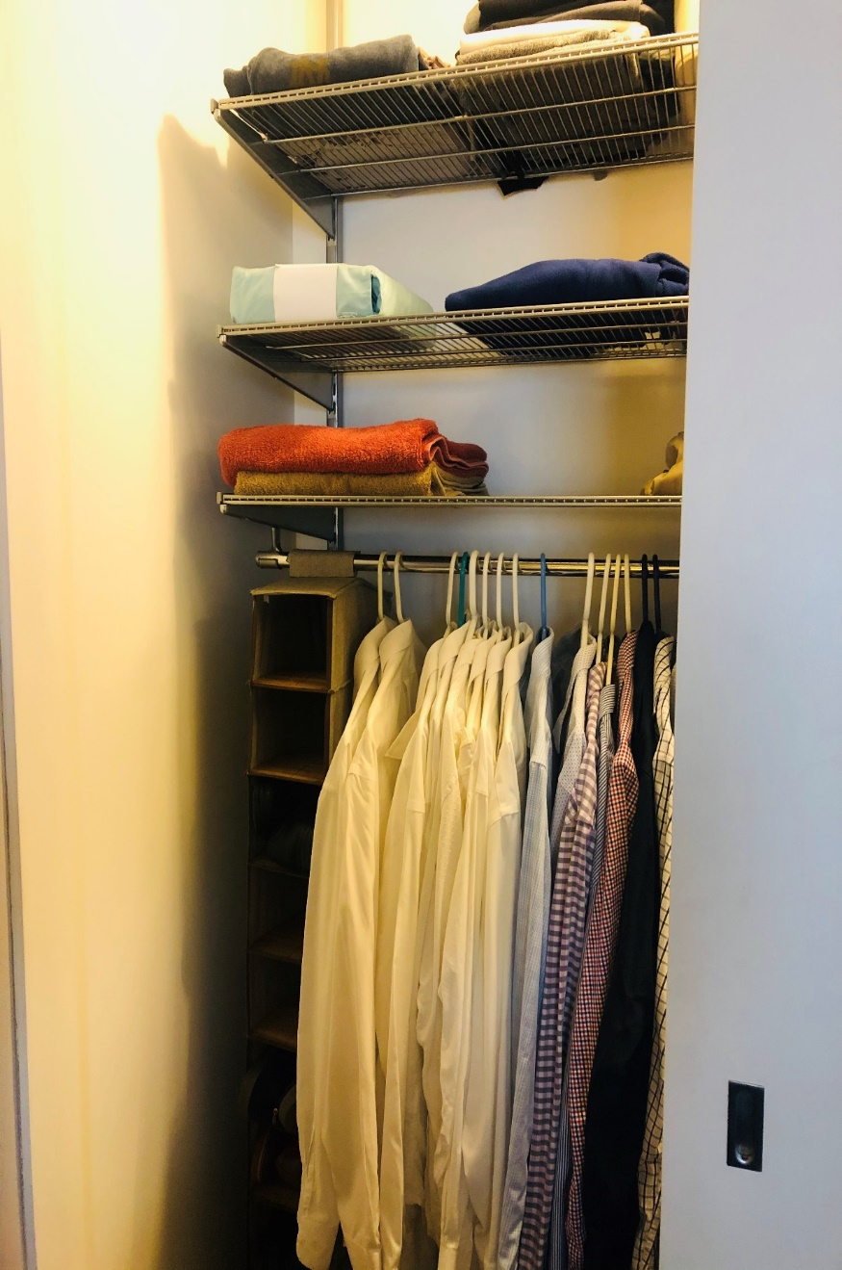
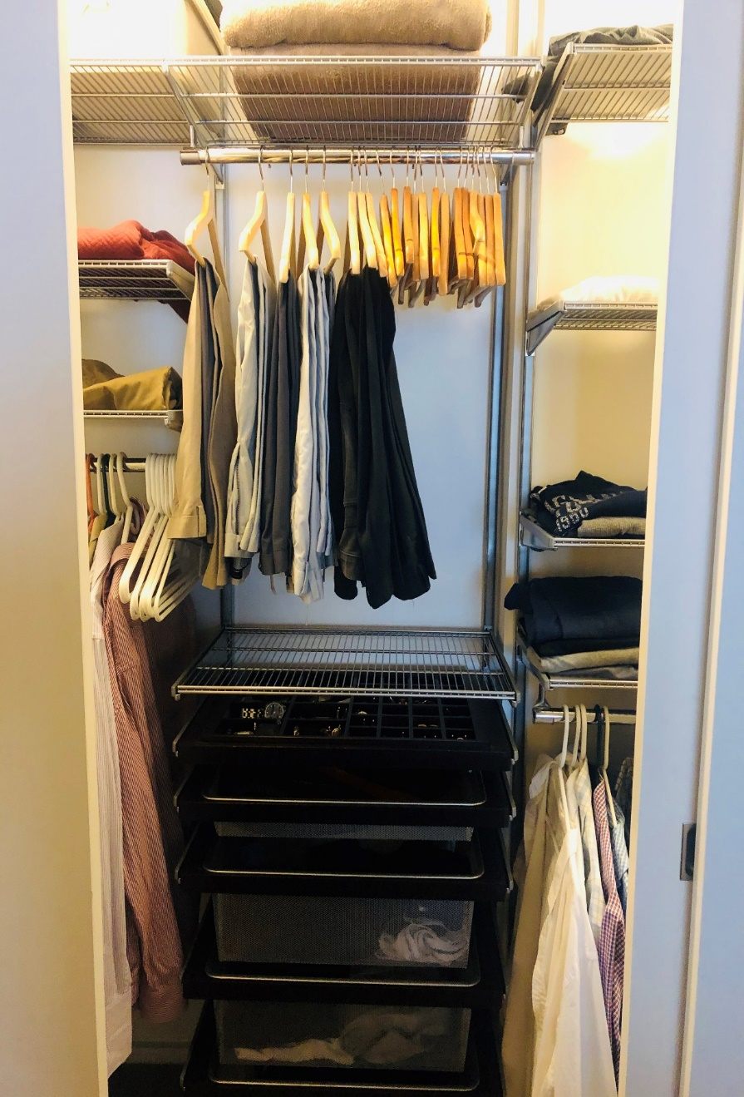
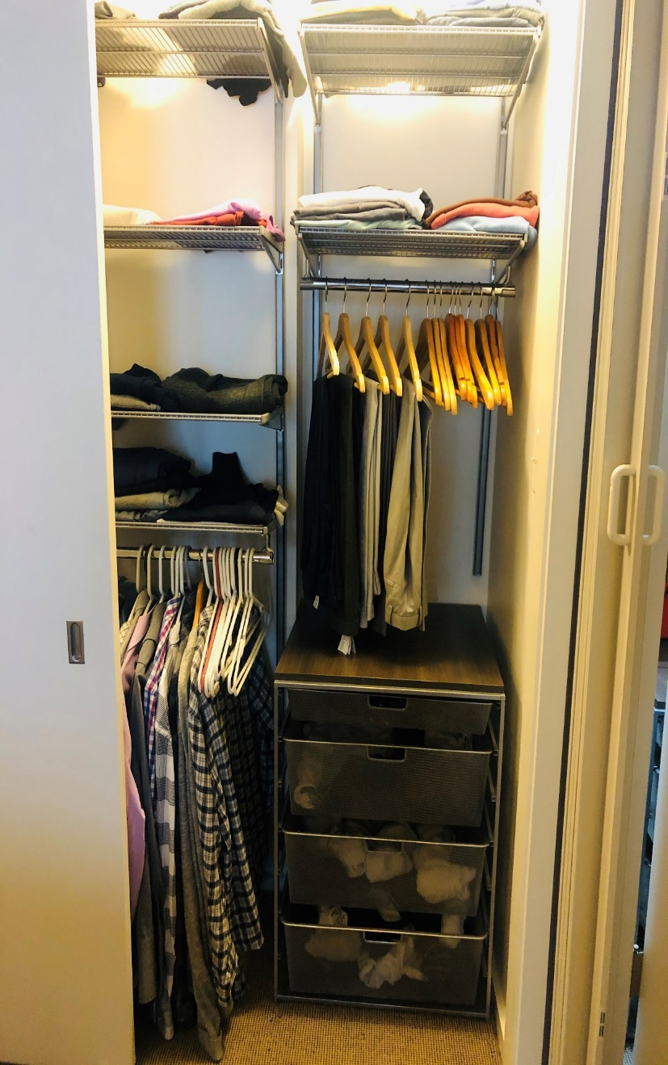
Elfa Bedroom Closet

Slide 6
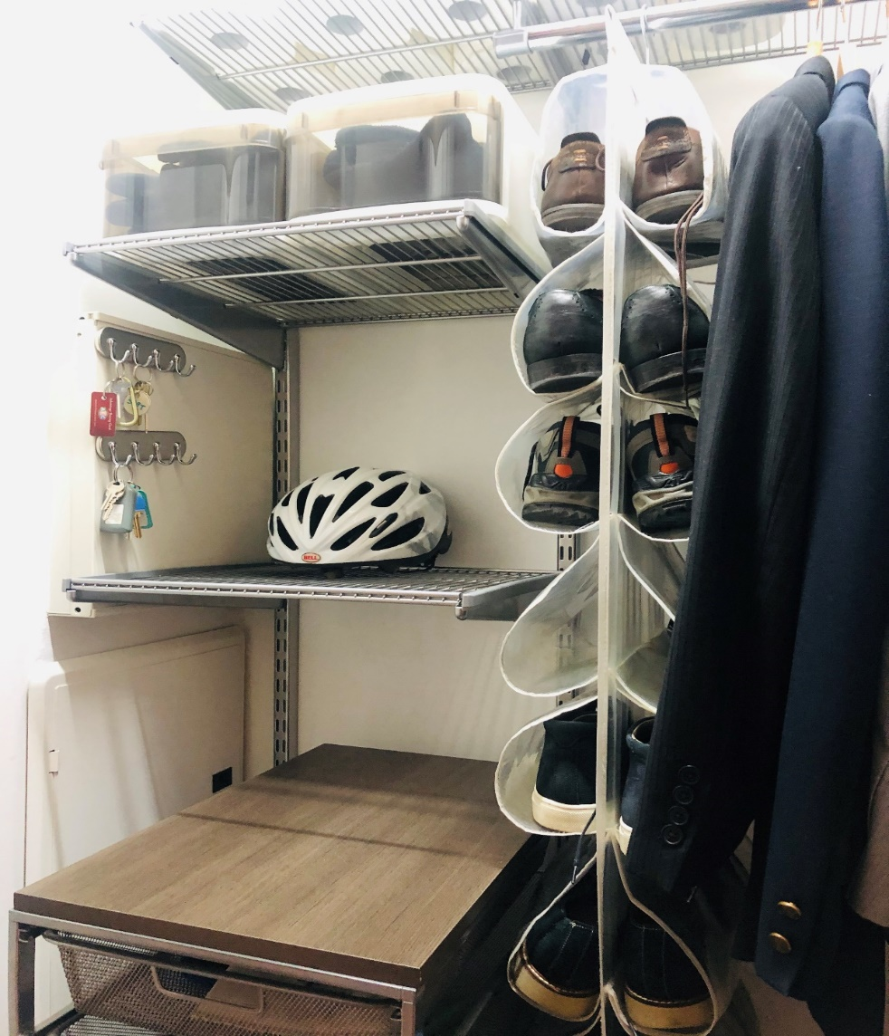
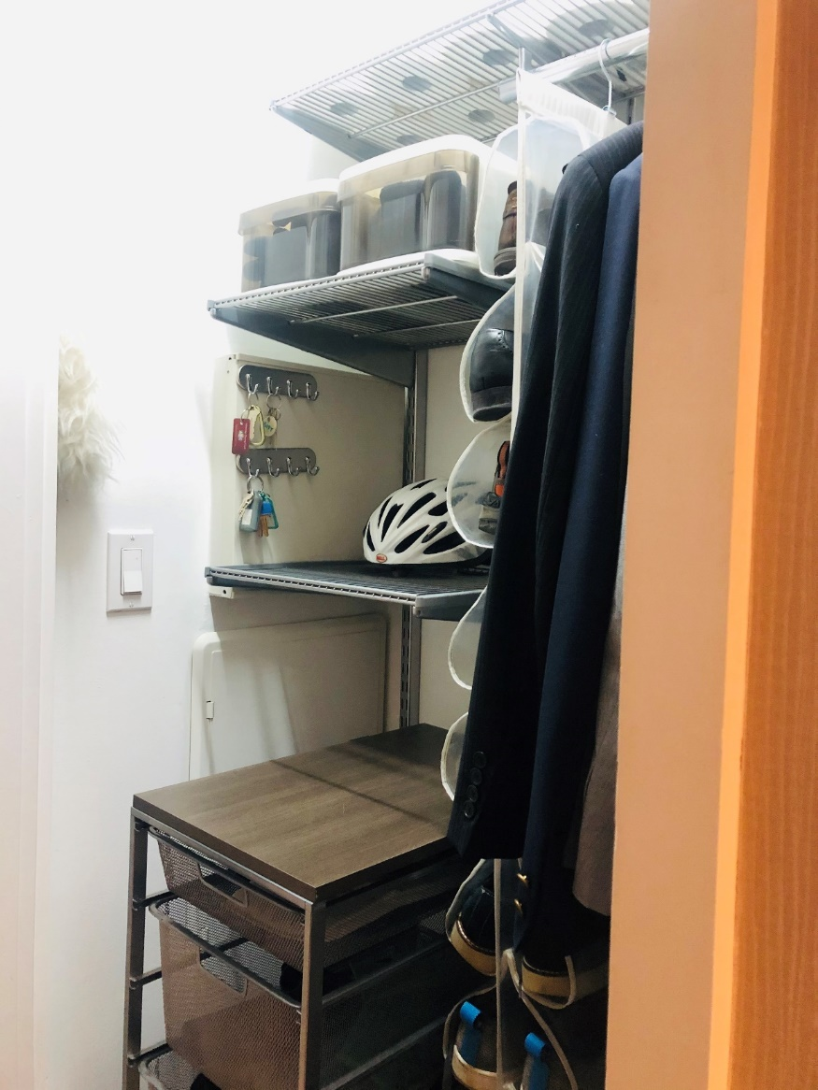
Elfa Hallway Closet

Slide 7
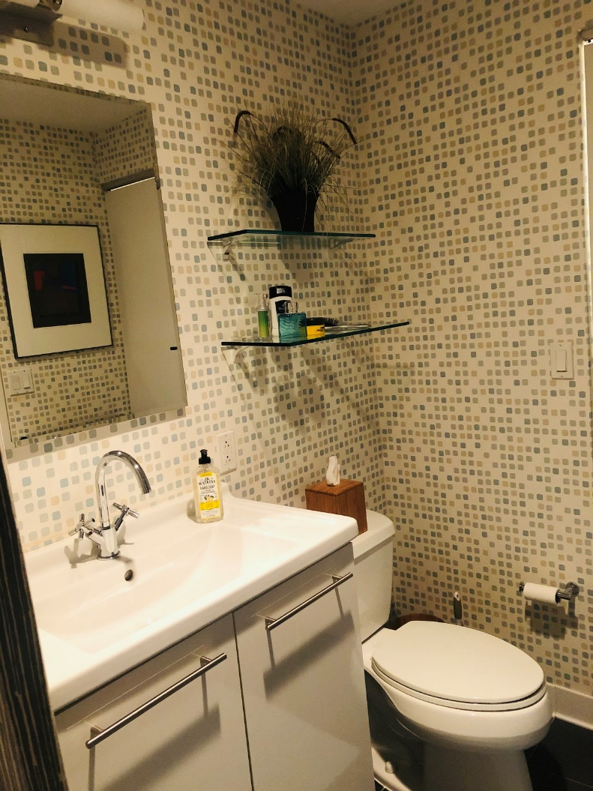
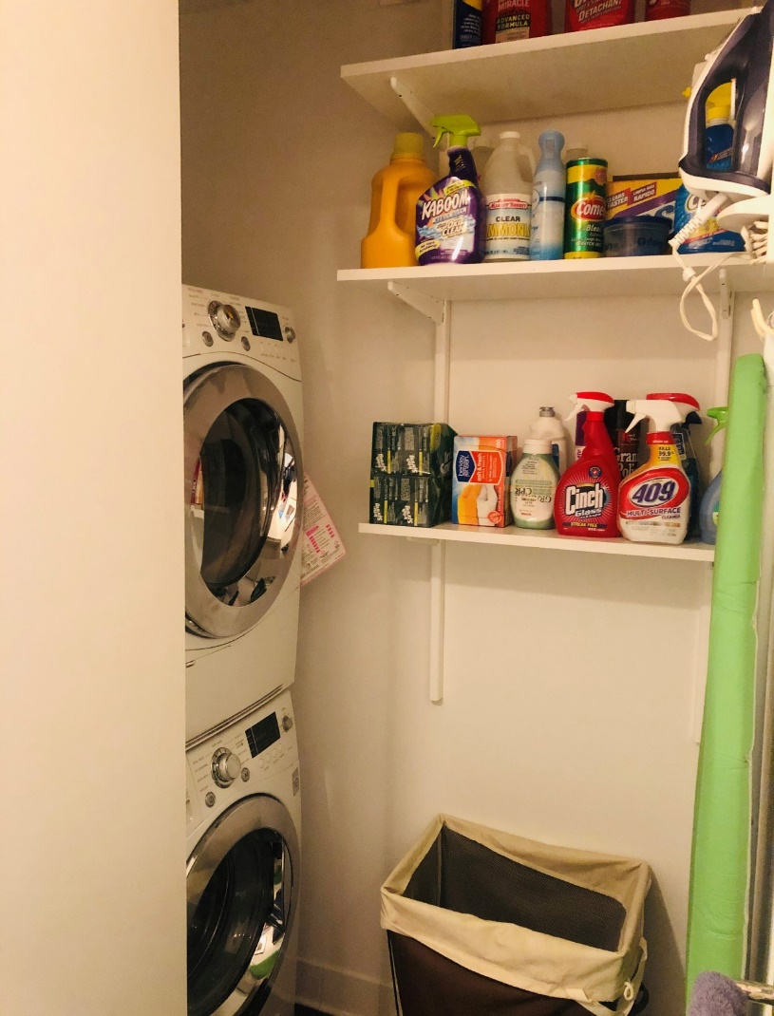
Full Bathroom
Washer & Dryer

Slide 8
Condo Fees $443.00
Condo Parking Fee $45.00
Average Electrical $55.00
Real-estate Taxes $1144.65
Condominium Documents available
UNIQUE Heating and Cooling 781-202-5636

